Slide 1
Iteration #3
Tech Lithe Creations

Slide 2
Agenda
Problem Restatement
What is a Use Case?
List of Use Cases
Use Case Example
Prototypes
Accessing About Page
Accessing Contact Us Page
Uploading Documents
Donation Page
Creating Membership

Slide 3
Problem Restatement
KY HBPA’s site lacks functionality and accessibility that is common among other organizations similar to them.
To improve access to KY HBPA information for the public, the site will need to fix the issues below.
Issues:
Payment of online transactions
Online form electronic signatures
Storage/backup of member and organizational data
Forms for license application and membership
Shared document library

Slide 4
What is a Use Case?
Describes how the user interacts with the system
Each use case breaks down a single function into detailed steps
Simplifies and clarifies interactions between users and the yet to exist system

Slide 5
List of Use Cases
Medium and Low Risk Use Cases
Displaying social media links
Accessing Partner Organizations
Accessing KYHBPA “About Us”
Accessing news page
Accessing calendar Page
Learn how to push for legislation
Access FAQ’s
Accessing Racing Education page
Accessing Trainers Page
View a Photo Gallery
Access Track Information
Access Other Chapters’ Information
Submit an information request
Subscribe to newsletter
Access news archives
Post photos
Access Jennie Rees Blog
High Risk Use Cases
Paying transactions online
Submitting forms for membership information
Submitting digital signatures for forms
Making Online Donations
Polling Members
Accessing contact Page
Accessing documents Page

Slide 6

Use Case Example
Submitting Forms for Membership Information
Notes:
Use Case Name: Submitting forms for membership information
ID: 02
Level of Importance: High
Primary Actors: Members-to-be
Stakeholders and Interests:
KY HBPA - Wants easy and organized storage of member information
Member-to-be - Wants to become a member of KY HBPA
Brief Description: Membership to the KY HBPA would be increased due to the ease of access and entry of the user’s information required for the membership. Forms would provide a simple service to the users who previously would have to submit a paper copy to the offices.
Trigger: Member clicks submit button on form
Type:
Relationships:
Main Flow of Events:
Access to KY HBPA website homepage
Access to form page through tab bar
Access to membership form through link on page

Slide 7
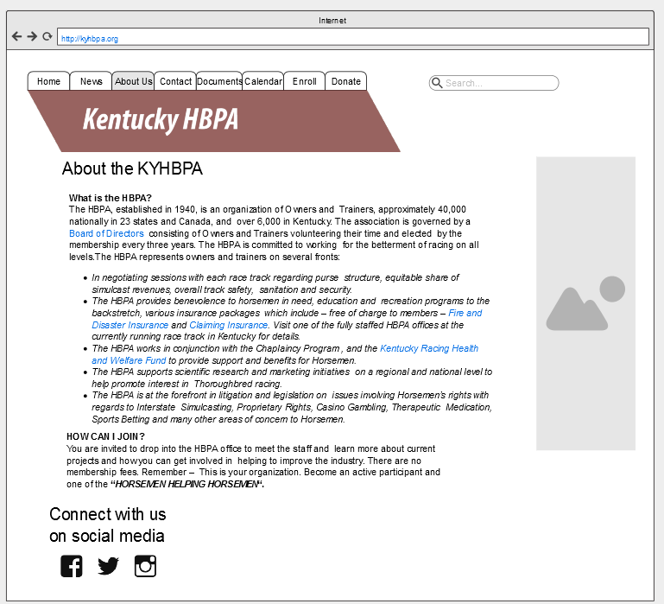
Prototypes

Slide 8
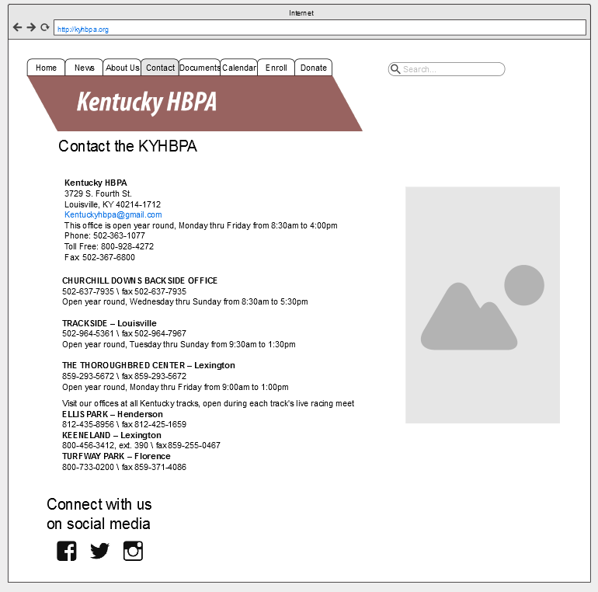
Prototypes

Slide 9
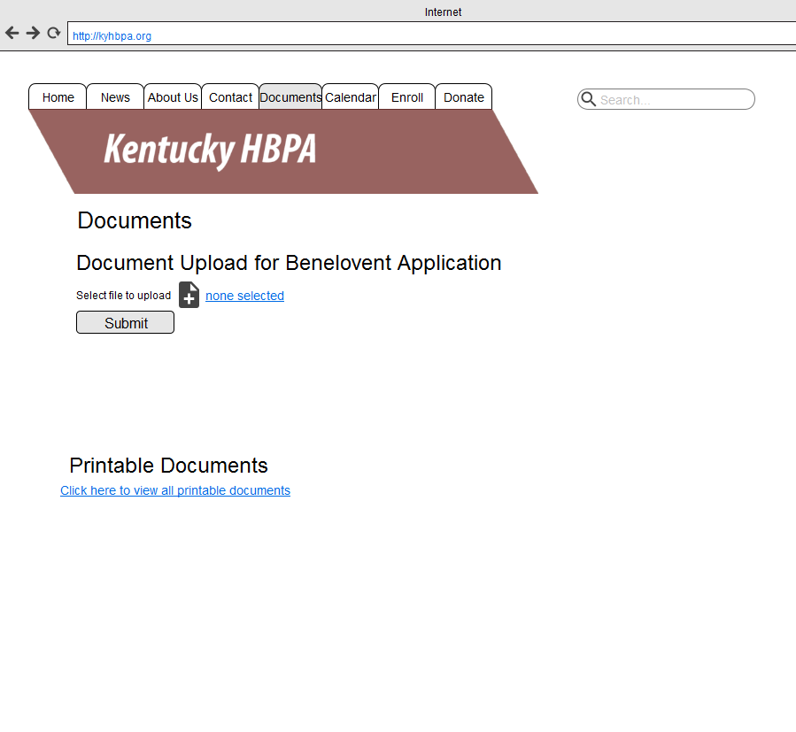
Prototypes

Slide 10
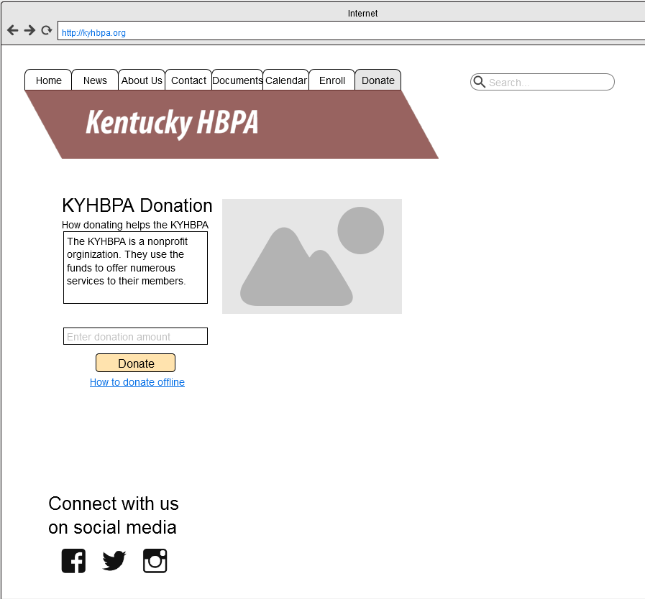
Prototypes

Slide 11
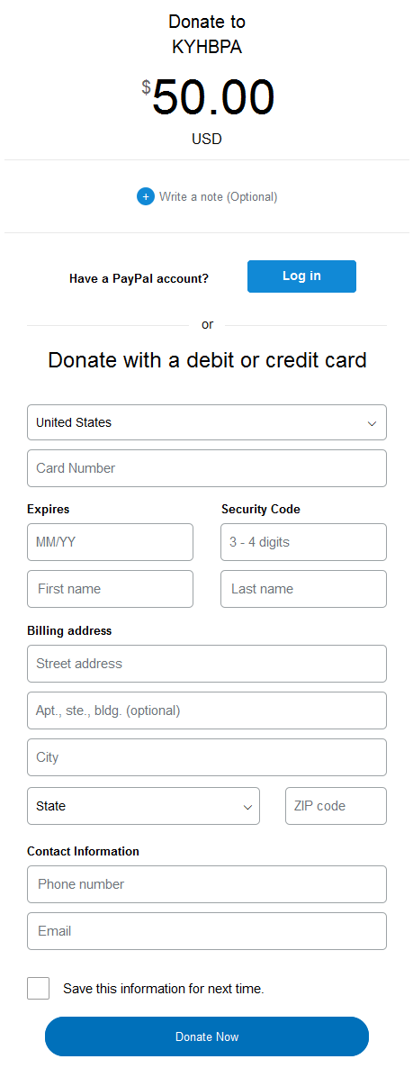
Prototypes

Slide 12
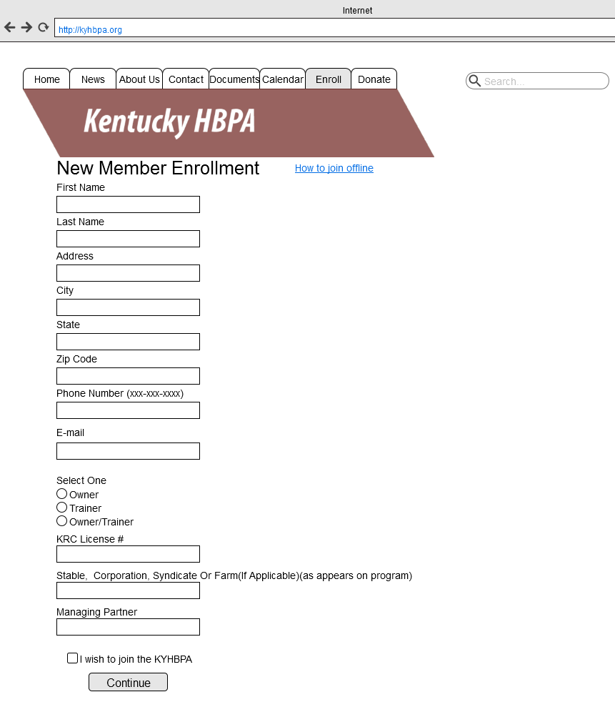
Prototypes

Slide 13
Agenda
Problem Restatement
What is a Use Case?
List of Use Cases
Use Case Example
Prototypes
Accessing About Page
Accessing Contact Us Page
Uploading Documents
Donation Page
Creating Membership

Slide 14
Questions?

